Slide 1
Number Of Strikes Story
File created on: 4/8/2025 2:50:09 PM

Slide 2
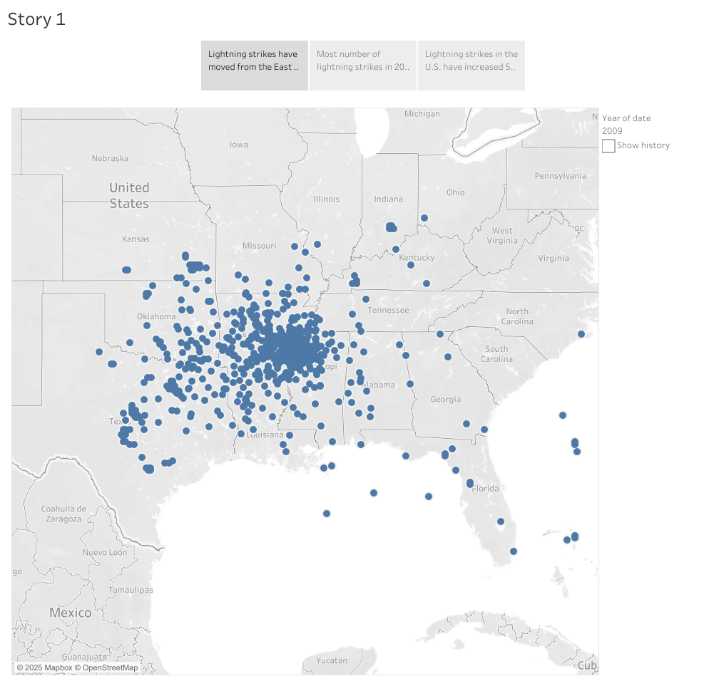

Slide 3
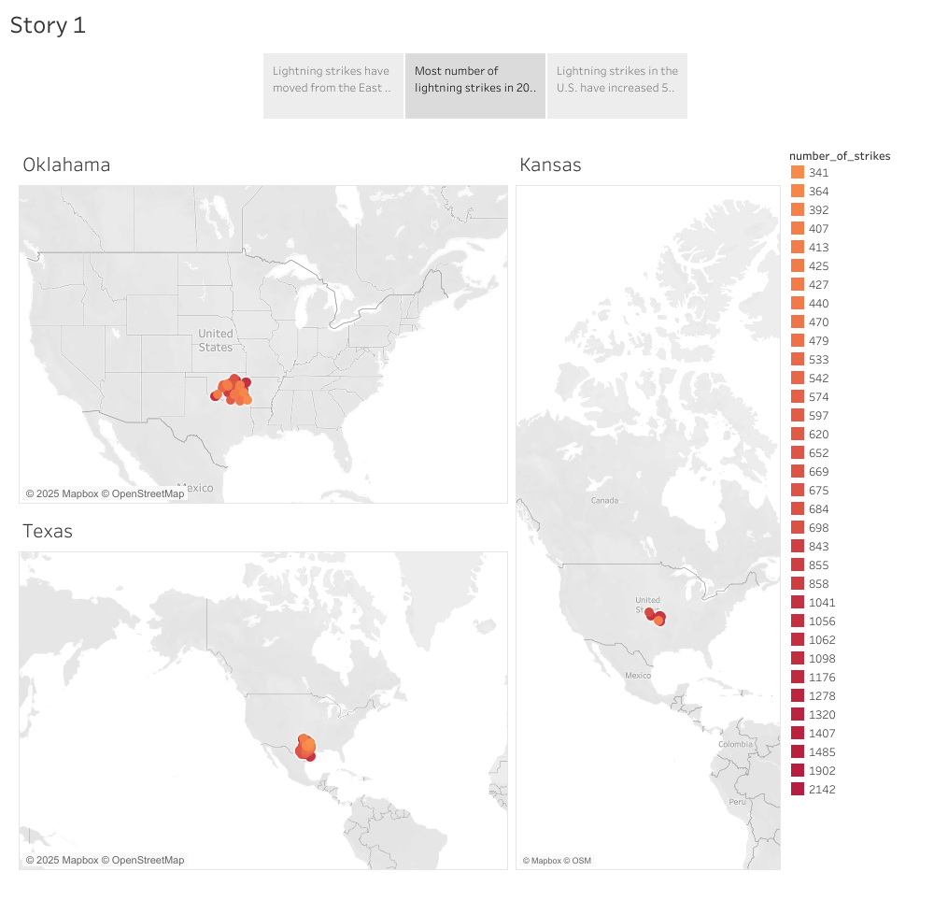

Slide 4
